Slide 1
Application Delivery Fundamentals 2.0 B: Java
Micro Service

Slide 2
Micro Service
Goals
Independent deployment of components
Independent scaling of components
Independent implementation stacks for each component
Easy self-serve deployments of components
Repeatable deployments of components (external configuration management)
Deployments without service interruptions

Slide 3
Micro Service
Goals
Protection of system availability from individual Instance failure
Automatic replacement of component instances when they fail (self-healing)
Easy scaling of components by adjusting a simple parameter value
Canary testing
"Red/black" or "blue/green" deployments
Instant reversal of new revision deployments

Slide 4
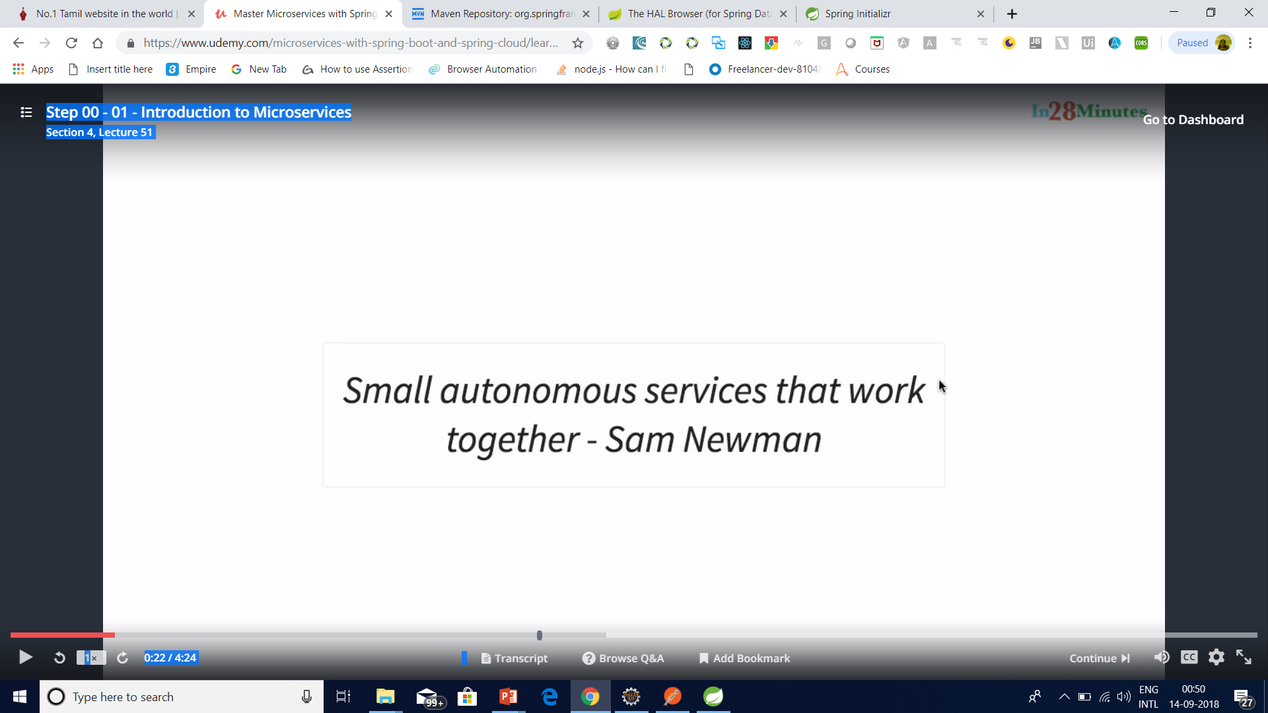
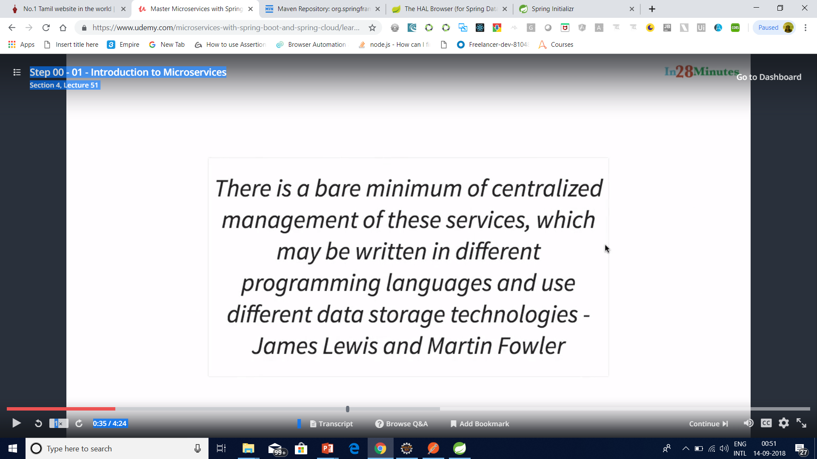
Micro Service

Slide 5

Micro Service

Slide 6
Micro Service

Slide 7

Micro Service

Slide 8

Micro Service

Slide 9
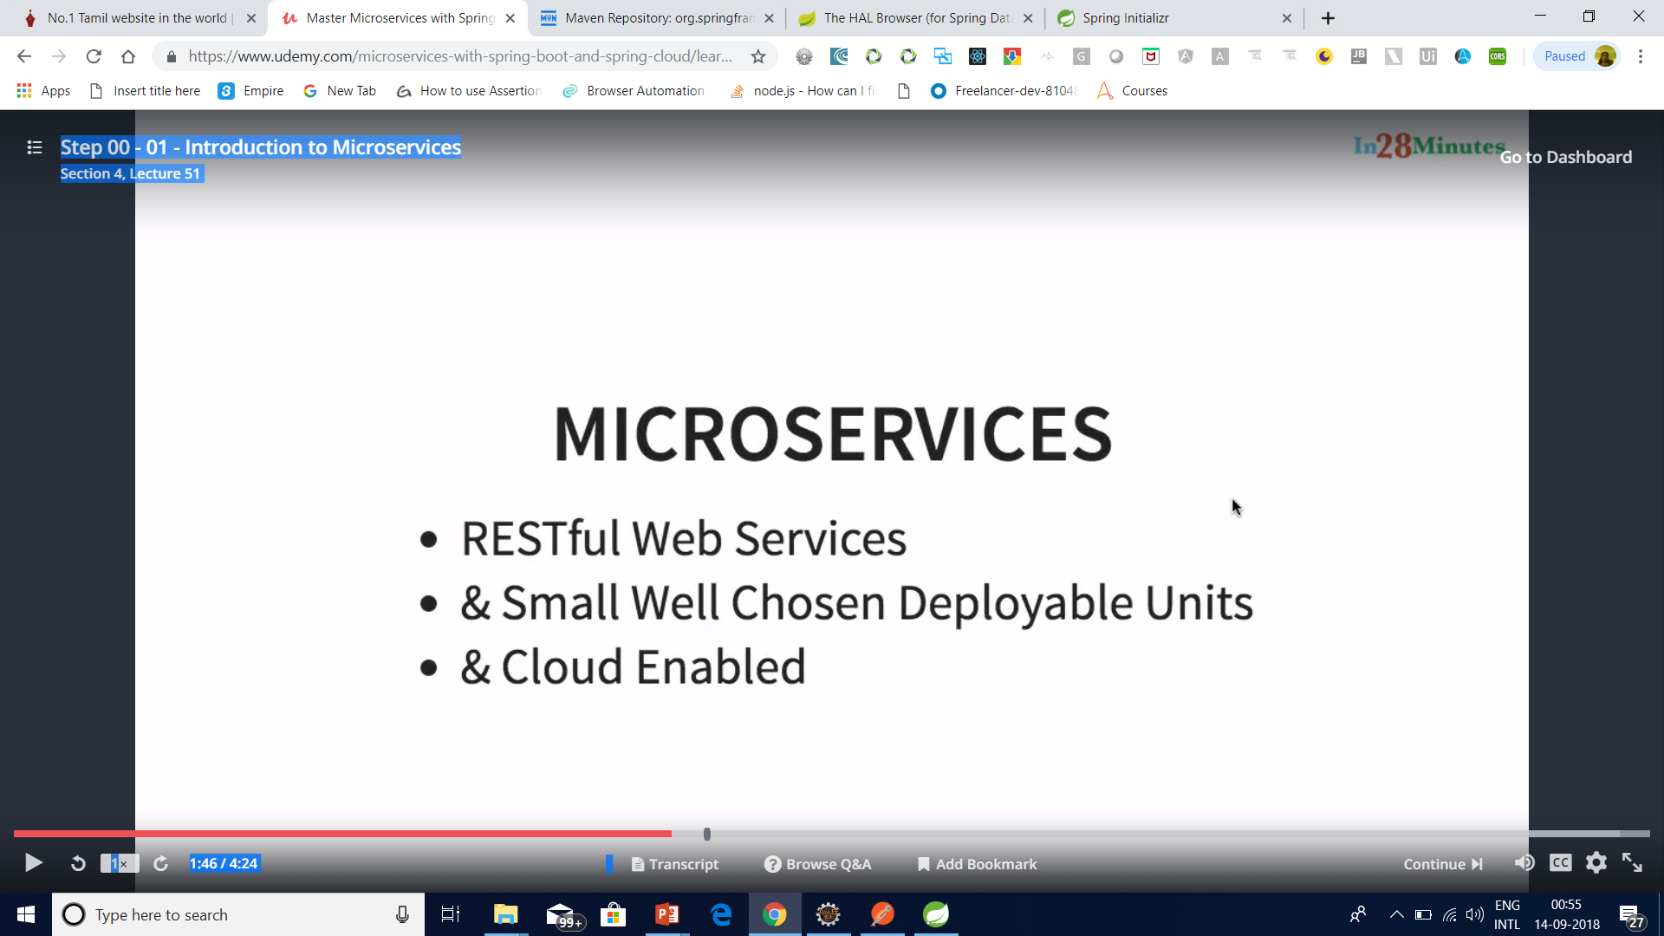
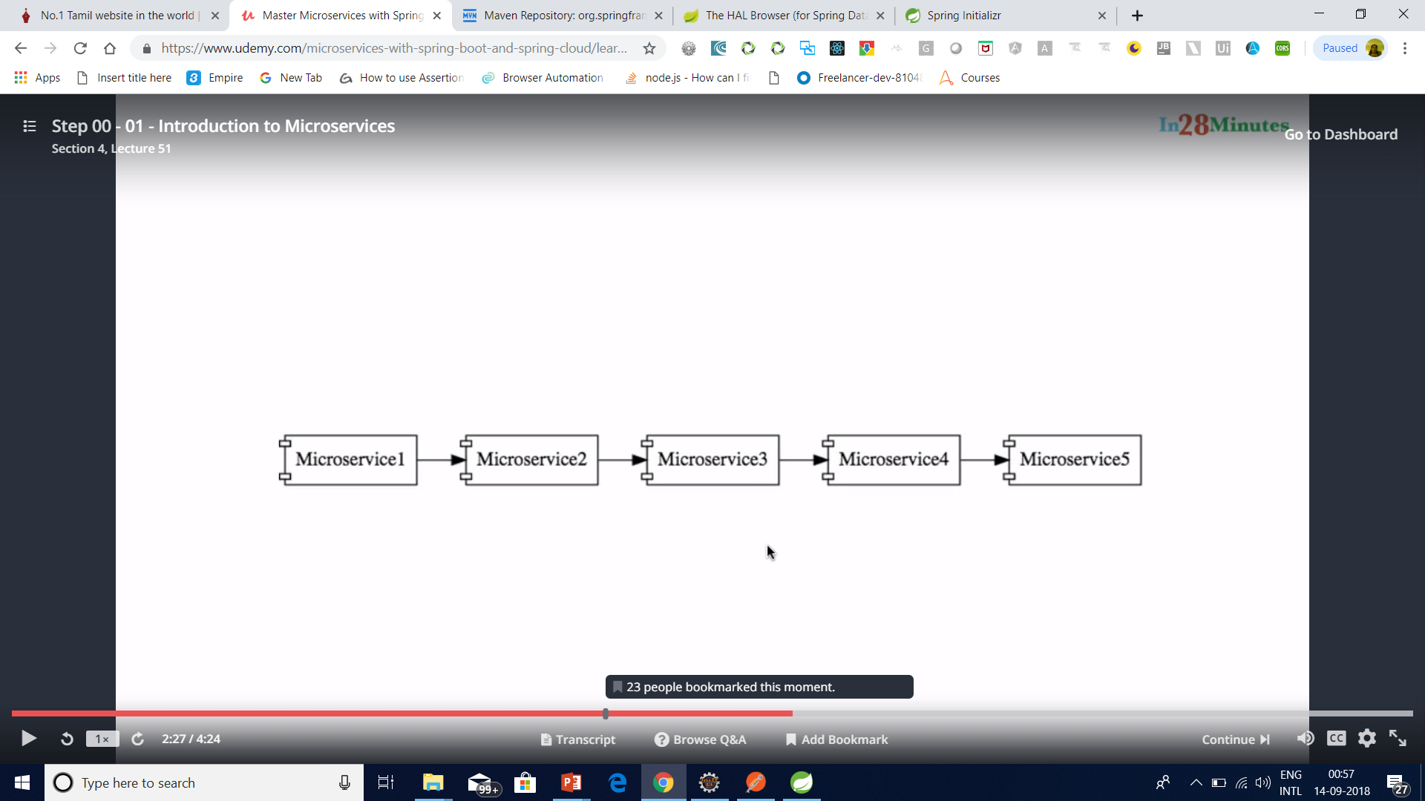
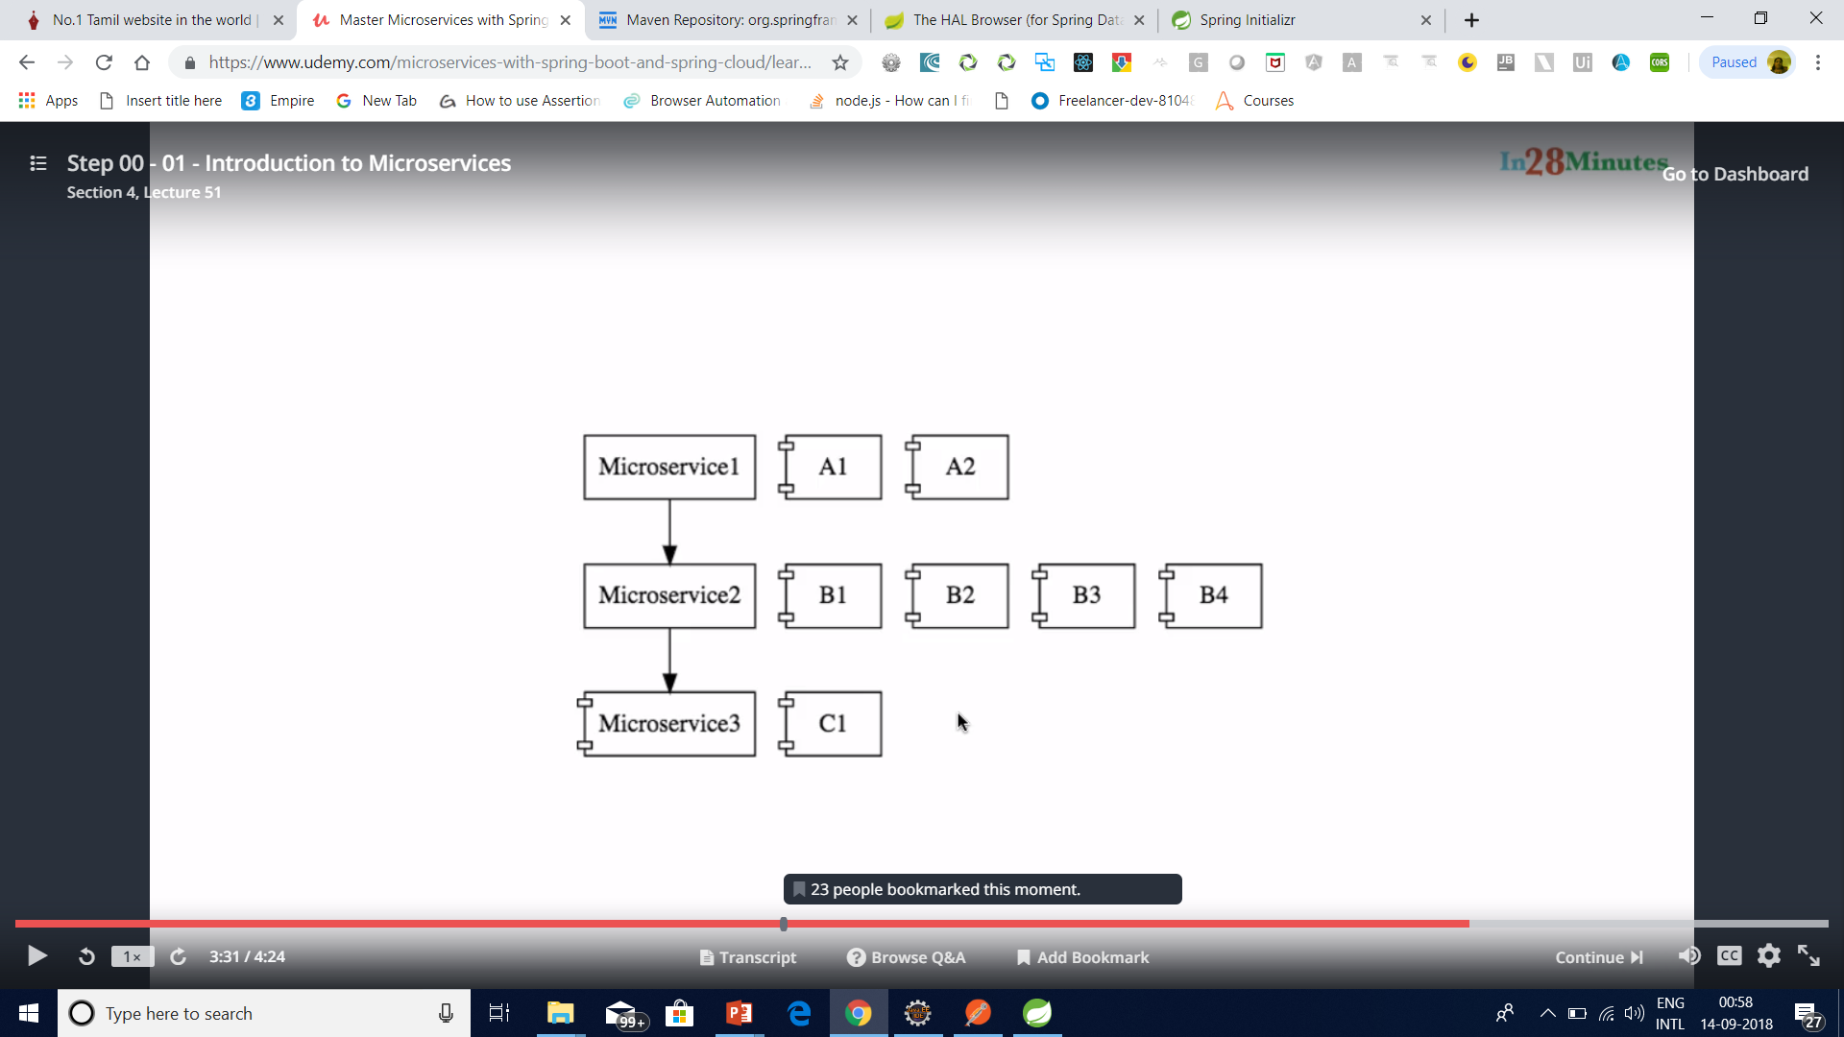
Micro Service

Slide 10
What is Microservices
Microservices is a variant of the service-oriented architecture (SOA) architectural style that structures an application as a collection of loosely coupled services.

Slide 11
What is Microservices
In a microservices architecture, services should be fine-grained and the protocols should be lightweight.
The benefit of decomposing an application into different smaller services is that it improves modularity and makes the application easier to understand, develop and test.

Slide 12
What is Microservices
It also parallelizes development by enabling small autonomous teams to develop, deploy and scale their respective services independently.

Slide 13
What are the Benefits of Microservices?
Smaller applications are not dependent on the same coding language, the developers can use the programming language that they are most familiar with.
That helps developers come up with a program faster with lower costs and fewer bugs.
The agility and low costs can also come from being able to reuse these smaller programs on other projects, making it more efficient.

Slide 14
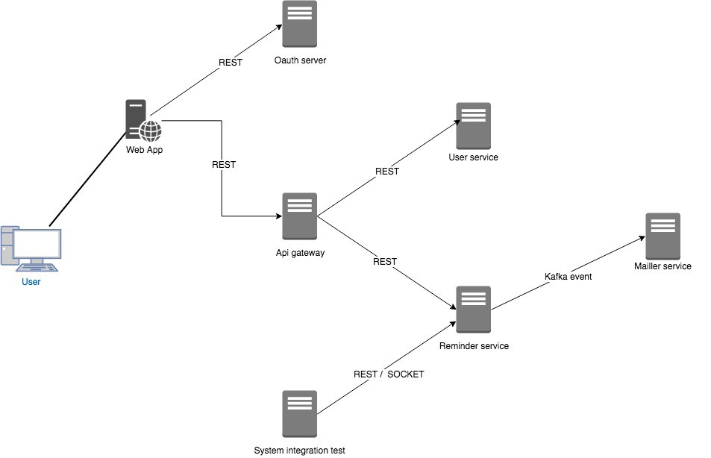

Slide 15
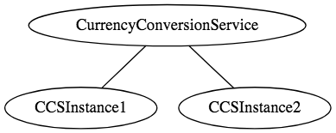
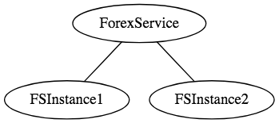
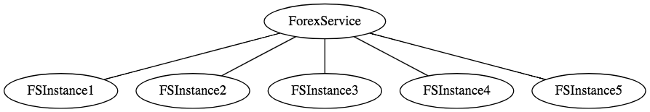
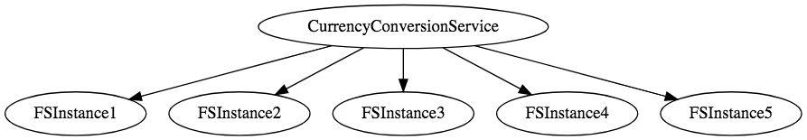

Slide 16
Examples of Microservices Frameworks for Java
There are several microservices frameworks that you can use for developing for Java. Some of these are:
Spring Boot. This is probably the best Java microservices framework that works on top of languages for Inversion of Control, Aspect Oriented Programming, and others.
Jersey. This open source framework supports JAX-RS APIs in Java is very easy to use.
Swagger. Helps you in documenting API as well as gives you a development portal, which allows users to test your APIs.

Slide 17
Challenges with Microservice Architectures
Quick Setup needed : You cannot spend a month setting up each microservice. You should be able to create microservices quickly.
Automation : Because there are a number of smaller components instead of a monolith, you need to automate everything - Builds, Deployment, Monitoring etc.
Visibility : You now have a number of smaller components to deploy and maintain. Maybe 100 or maybe 1000 components. You should be able to monitor and identify problems automatically. You need great visibility around all the components.

Slide 18
Challenges with Microservice Architectures
Bounded Context : Deciding the boundaries of a microservice is not an easy task. Bounded Contexts from Domain Driven Design is a good starting point. Your understanding of the domain evolves over a period of time. You need to ensure that the microservice boundaries evolve.
Configuration Management : You need to maintain configurations for hundreds of components across environments. You would need a Configuration Management solution
Dynamic Scale Up and Scale Down : The advantages of microservices will only be realized if your applications can scaled up and down easily in the cloud.
Pack of Cards : If a microservice at the bottom of the call chain fails, it can have knock on effects on all other microservices. Microservices should be fault tolerant by Design.

Slide 19
Challenges with Microservice Architectures
Debugging : When there is a problem that needs investigation, you might need to look into multiple services across different components. Centralized Logging and Dashboards are essential to make it easy to debug problems.
Consistency : You cannot have a wide range of tools solving the same problem. While it is important to foster innovation, it is also important to have some decentralized governance around the languages, platforms, technology and tools used for implementing/deploying/monitoring microservices.

Slide 20
Solutions to Challenges with Microservice Architectures
Spring Boot
Enable building production ready applications quickly
Provide non-functional features
embedded servers (easy deployment with containers)
metrics (monitoring)
health checks (monitoring)
externalized configuration

Slide 21
Solutions to Challenges with Microservice Architectures
Spring Cloud
Spring Cloud provides solutions to cloud enable your microservices.
It leverages and builds on top of some of the Cloud solutions opensourced by Netflix (Netflix OSS).

Slide 22
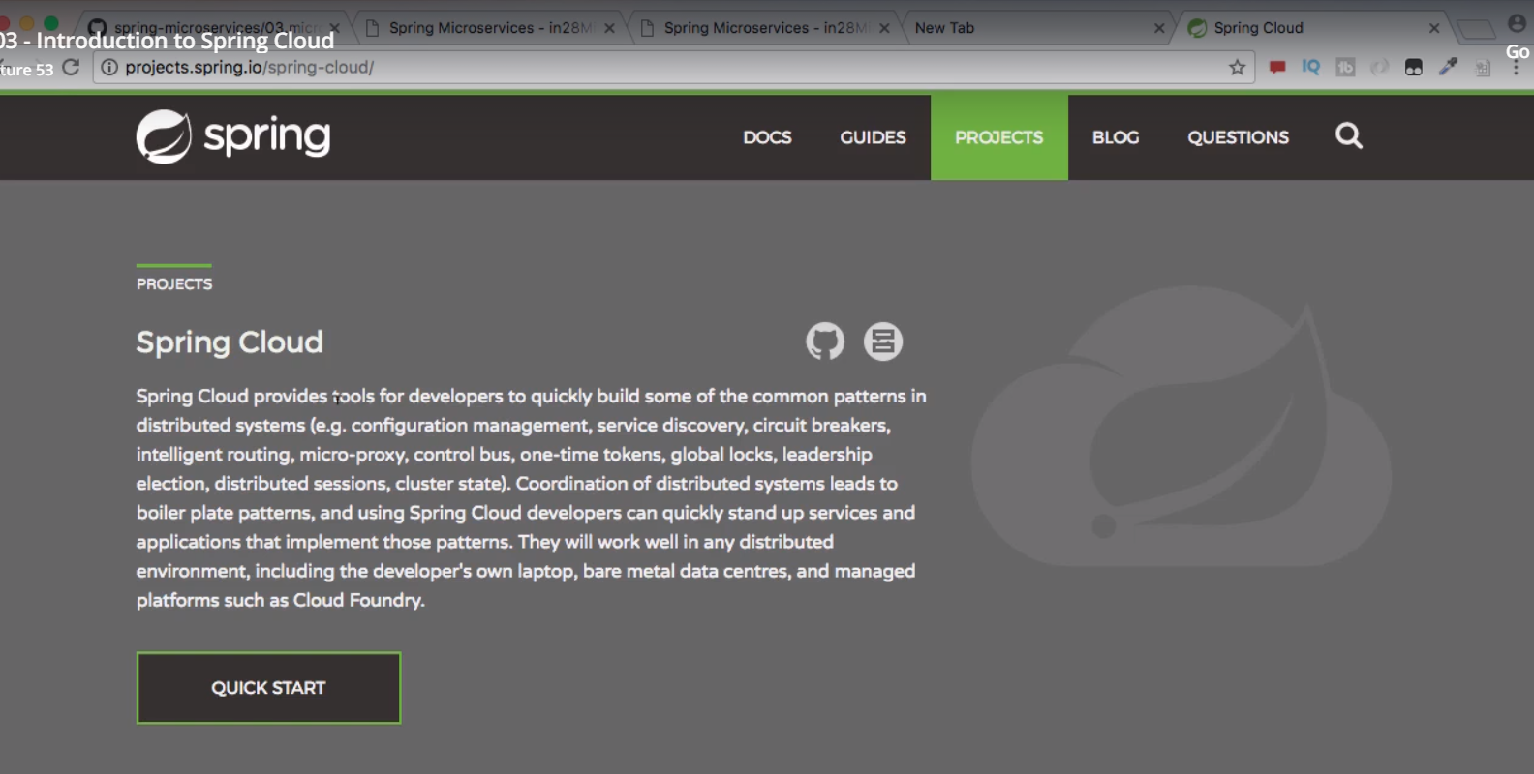
Spring Cloud

Slide 23
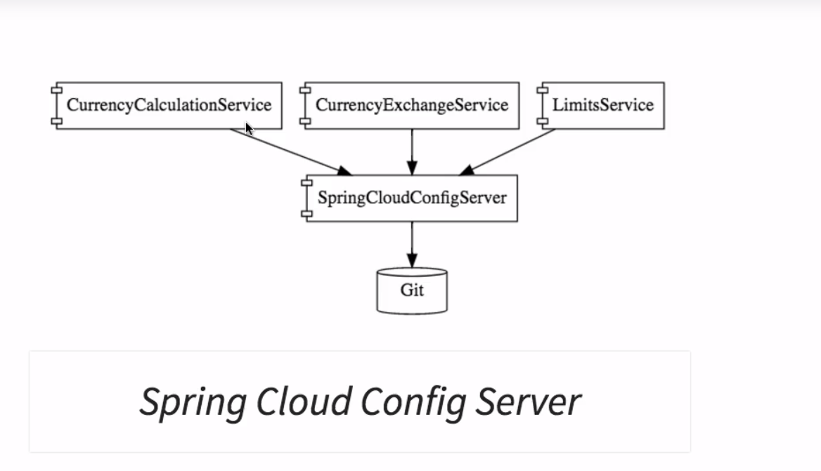
Spring Cloud

Slide 24
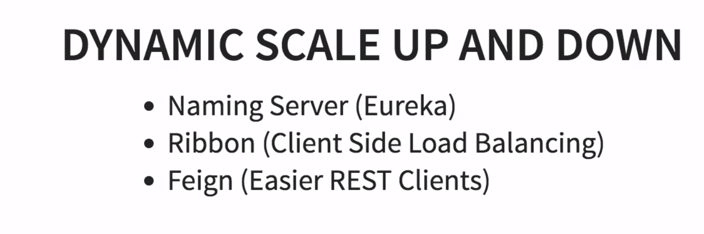
Spring Cloud

Slide 25
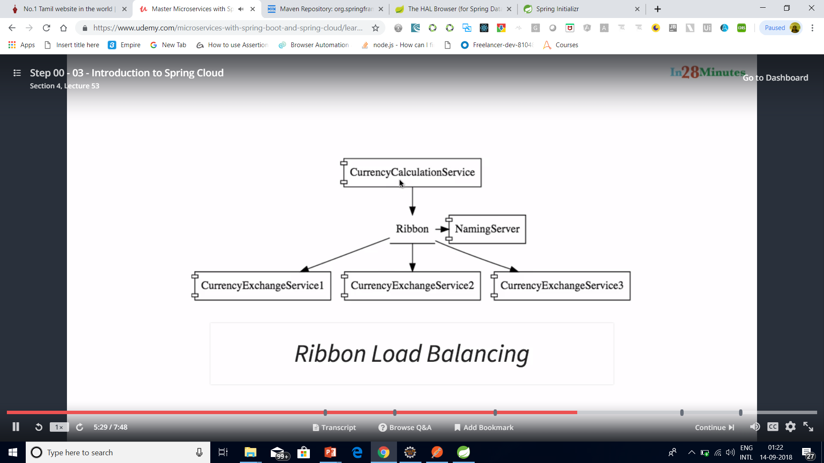
Spring Cloud

Slide 26
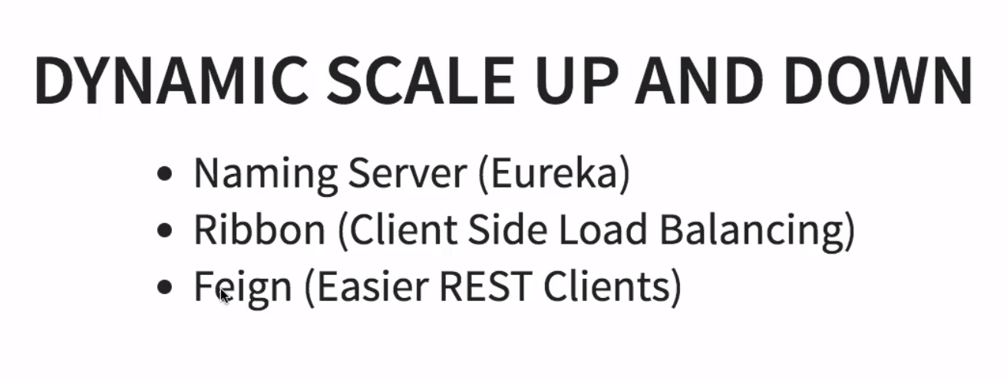
Spring Cloud

Slide 27
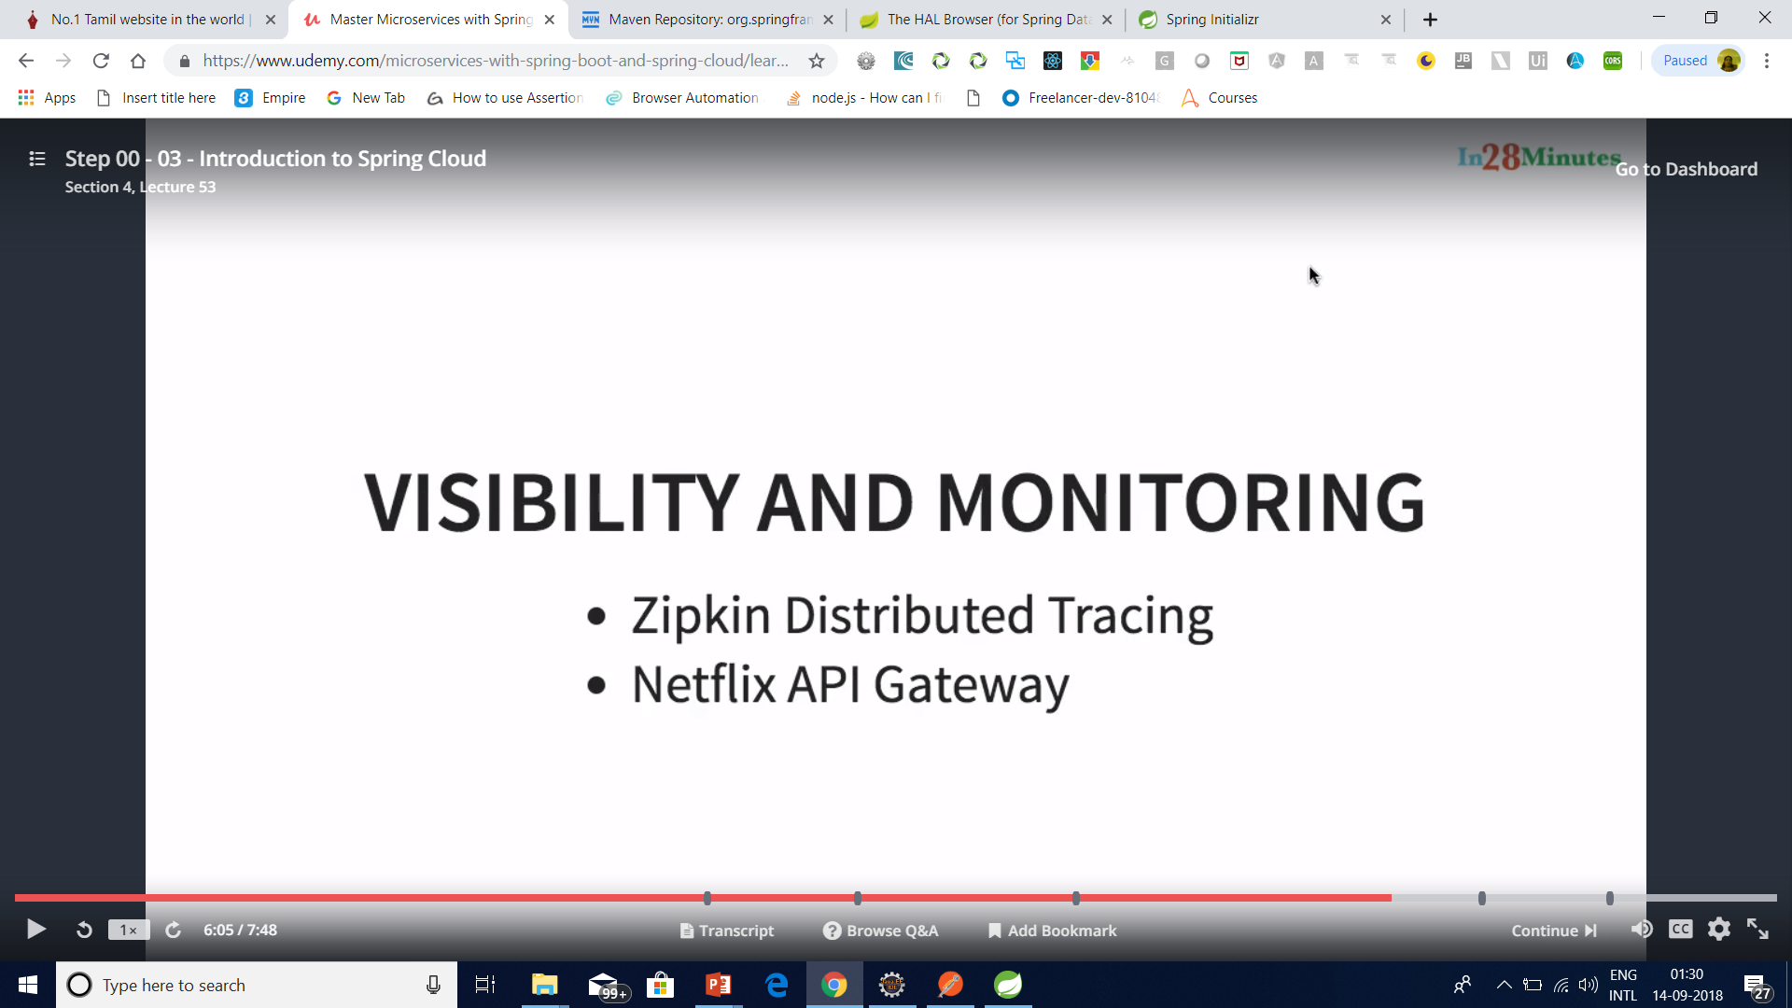
Spring Cloud

Slide 28
Important Spring Cloud Modules
Dynamic Scale Up and Down. Using a combination of
Naming Server (Eureka)
Ribbon (Client Side Load Balancing)
Feign (Easier REST Clients)
Visibility and Monitoring with
Zipkin Distributed Tracing
Netflix API Gateway
Configuration Management with
Spring Cloud Config Server
Fault Tolerance with
Hystrix

Slide 29
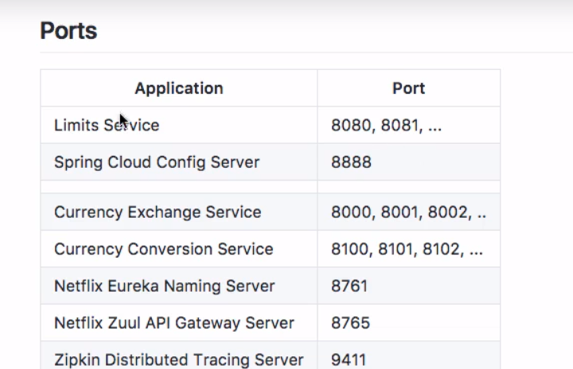
Standardized ports

Slide 30
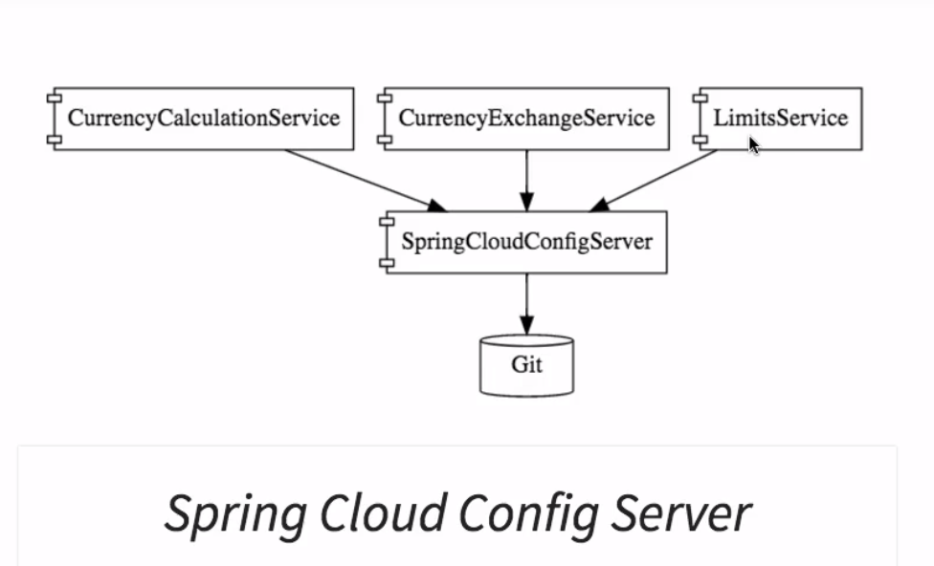
Spring Cloud Config Server with git

Slide 31
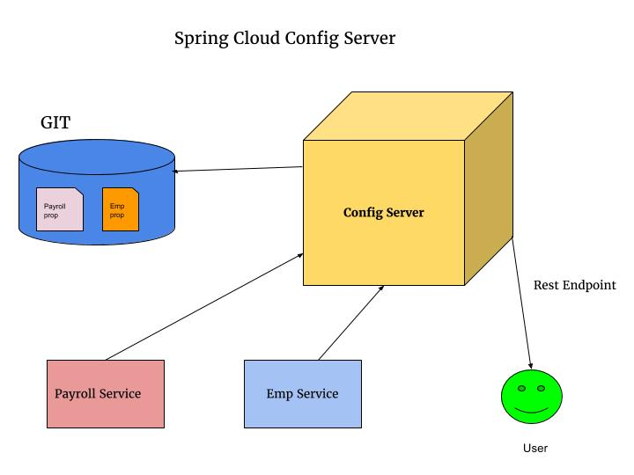
Spring Cloud Config Server with git

Slide 32
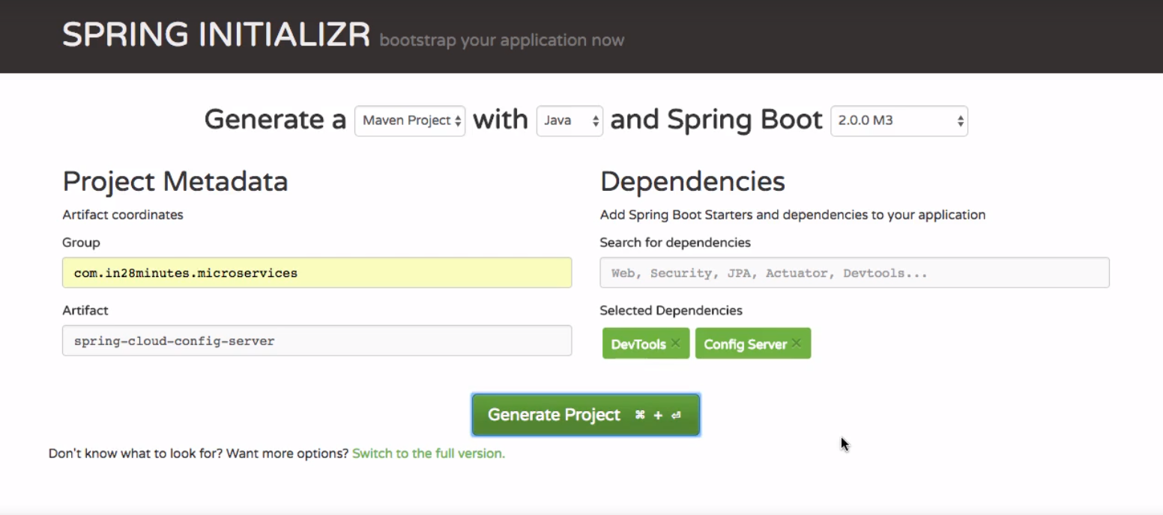
Spring Cloud Config Server with git

Slide 33
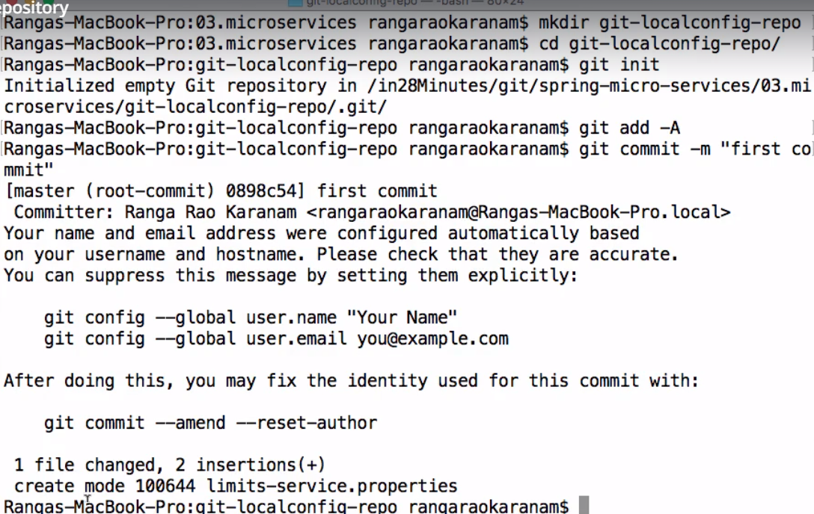
Spring Cloud Config Server with git

Slide 34
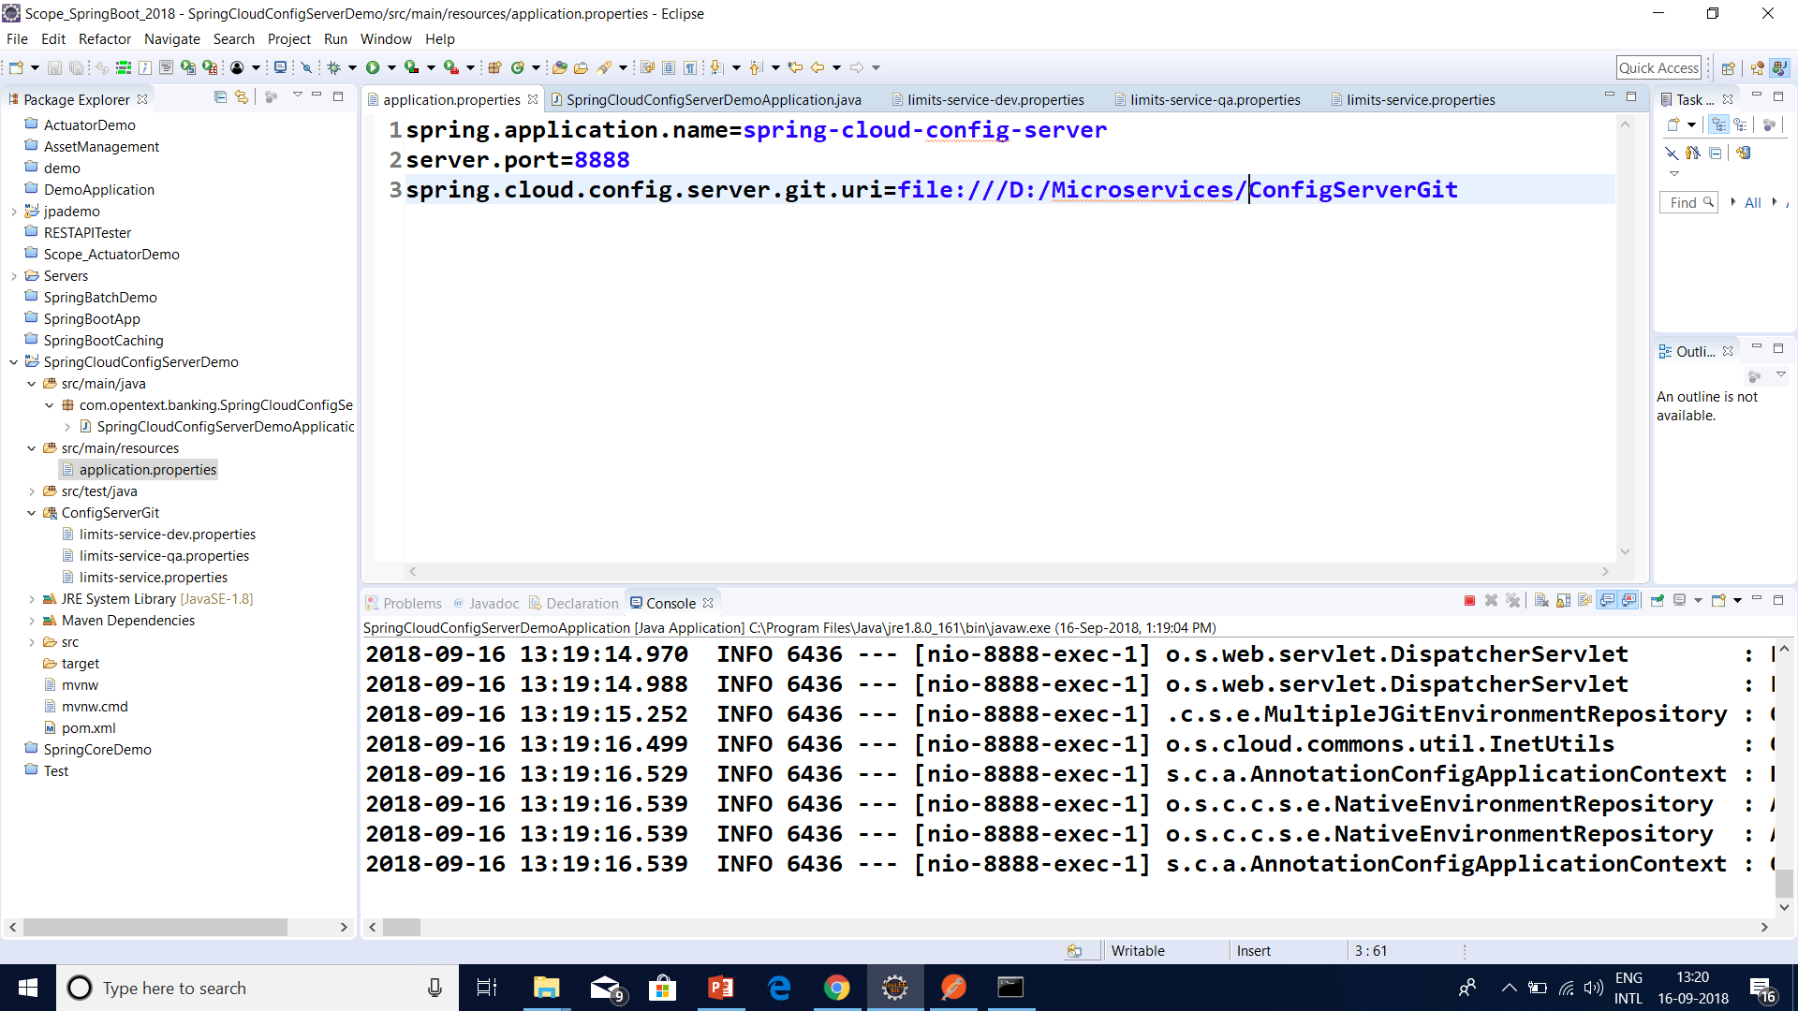
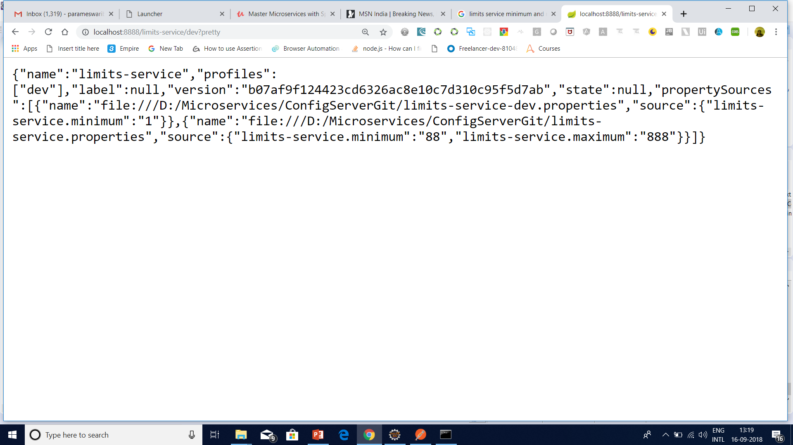
Spring Cloud Config Server with git

Slide 35
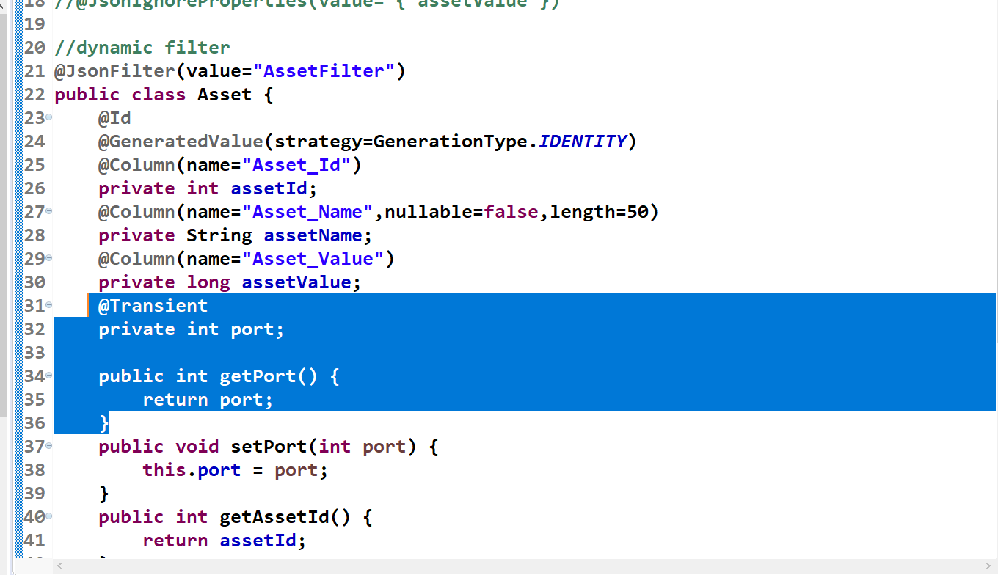
Micro service With Multiple Port

Slide 36
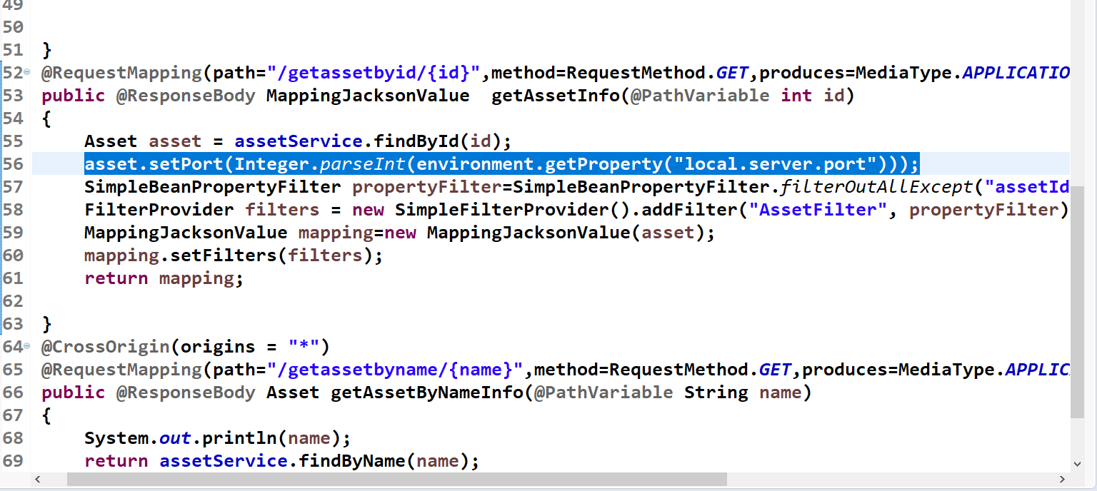
Micro service With Multiple Port

Slide 37
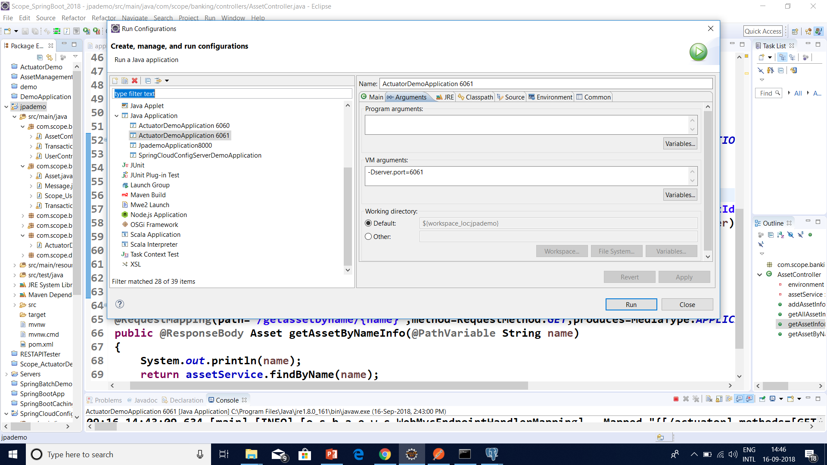
Micro service With Multiple Port

Slide 38
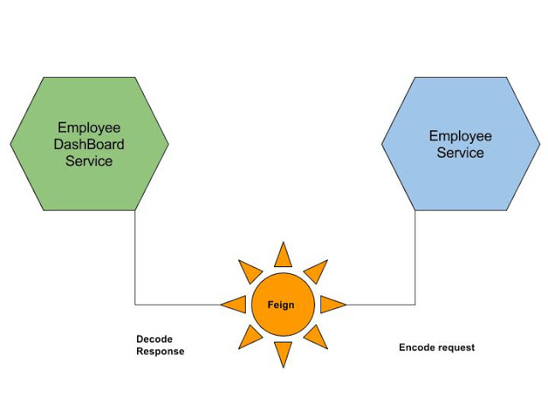
Feign Client

Slide 39
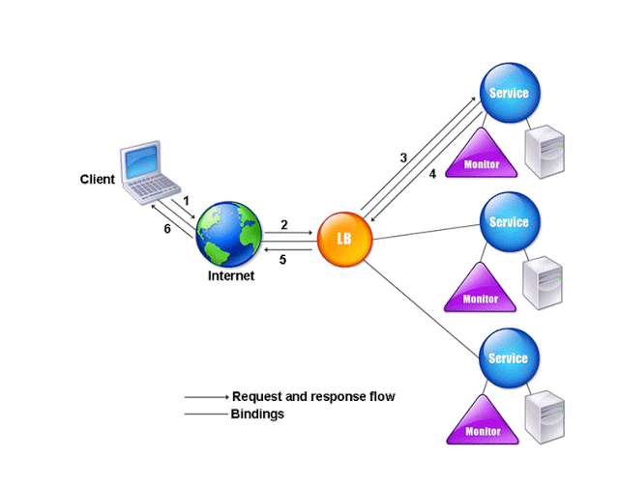
RIBBON LOAD BALANCER

Slide 40
RIBBON LOAD BALANCER
Ribbon is a client-side load balancer, which gives you a lot of control over the behavior of HTTP and TCP clients.
Ribbon's Client component offers a good set of configuration options such as connection timeouts, retries, retry algorithm (exponential, bounded back off) etc.
Ribbon comes built in with a pluggable and customizable Load Balancing component.

Slide 41
RIBBON LOAD BALANCER
Some of the load balancing strategies offered are listed below:
Simple Round Robin LB
Weighted Response Time LB
Zone Aware Round Robin LB
Random LB

Slide 42
RIBBON LOAD BALANCER
Ribbon provides the following features:
Load balancing
Fault tolerance
Multiple protocols (HTTP, TCP, UDP) support in an asynchronous and reactive model
Caching and batching

Slide 43
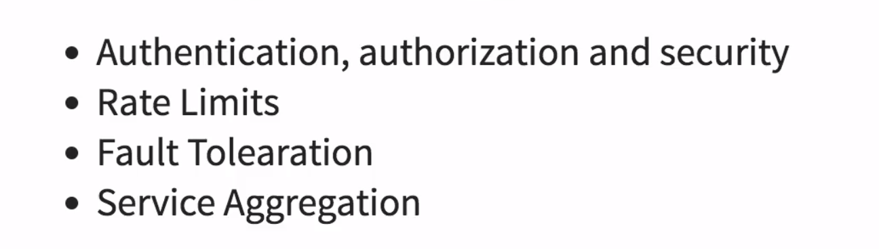
API Gateway

Slide 44
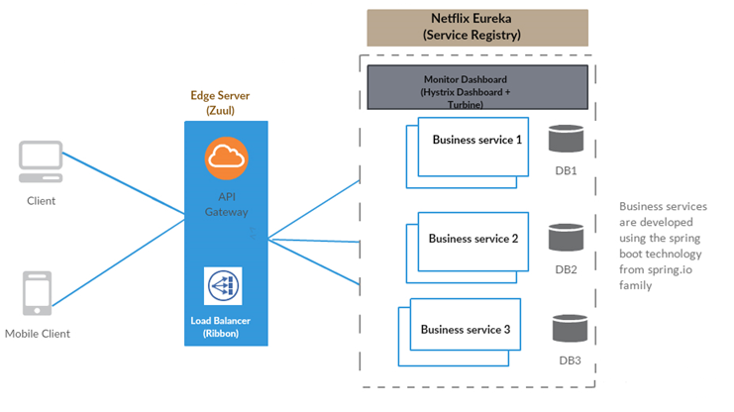

Slide 45
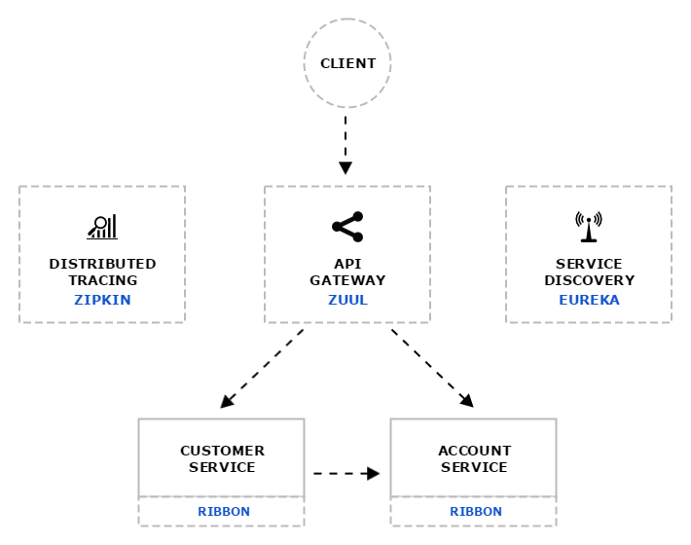
Distributed tracing system with request visualization.
Monitoring, routing and security
client side Load Balancers

Slide 46
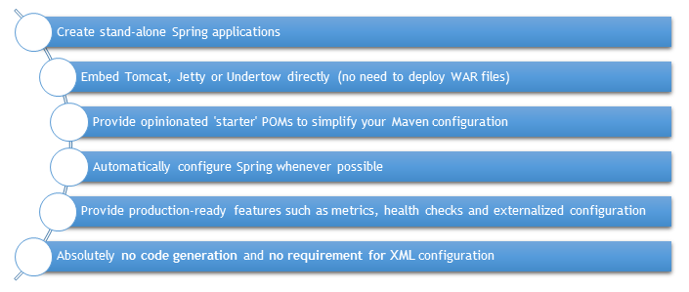
Spring Boot and Microservices

Slide 47
What is Zuul?
Zuul is the front door for all requests from devices and web sites to the backend of the Netflix streaming application.
As an edge service application, Zuul is built to enable dynamic routing, monitoring, resiliency and security.
It also has the ability to route requests to multiple Amazon Auto Scaling Groups as appropriate.

Slide 48
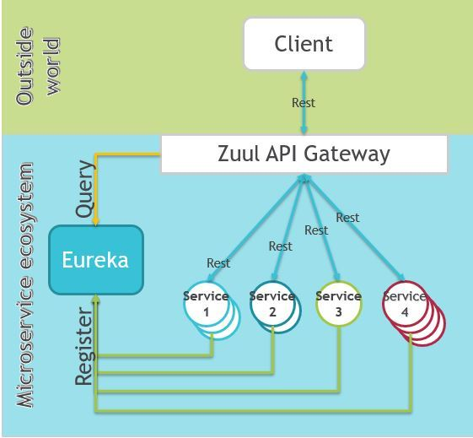
What is Zuul?

Slide 49
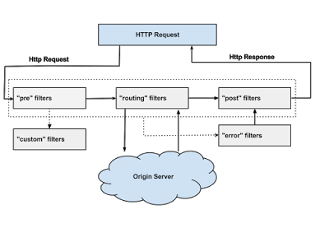

Slide 50
Why did we build Zuul?
The volume and diversity of Netflix API traffic sometimes results in production issues arising quickly and without warning.
We need a system that allows us to rapidly change behaviour in order to react to these situations.

Slide 51
Zuul Filetrs
Authentication and Security – identifying authentication requirements for each resource and rejecting requests that do not satisfy them.

Slide 52
Zuul Filetrs
Insights and Monitoring – tracking meaningful data and statistics at the edge in order to give us an accurate view of production.

Slide 53
Zuul Filetrs
Dynamic Routing – dynamically routing requests to different backend clusters as needed.

Slide 54
Zuul Filetrs
Stress Testing – gradually increasing the traffic to a cluster in order to gauge performance.

Slide 55
Zuul Filetrs
Load Shedding – allocating capacity for each type of request and dropping requests that go over the limit.

Slide 56
Zuul Filetrs
Static Response handling – building some responses directly at the edge instead of forwarding them to an internal cluster

Slide 57
Zuul Filetrs
Multiregion Resiliency – routing requests across AWS regions in order to diversify our Elastic Load Balancer usage and move our edge closer to our members

Slide 58
Questions

Slide 59
Module Summary
Spring Integration Framework.
Message, Channel and Adapter
Understood the different Component Integration
Understood the Event-Driven Architecture

